Slide 1
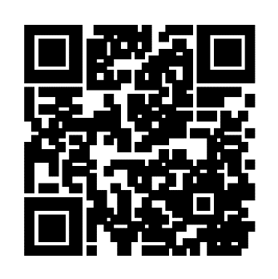
First Aid for Mental Health
See the world through the eyes of others
First Aid for Mental Health teaches you how to:
Identify when you or someone you know may be struggling with mental health
Start a conversation with someone who is struggling
Respond with empathy
Help those who are struggling get the help they need
Take action to manage your own mental health challenges
First Aid for Mental Health is for EVERYONE. Clergy and their spouses, Church leaders, staff and congregation members are all invited to attend—at no cost.
Visit the First Aid for Mental Health event page at wespath.org/r/firstaidmh to learn more.

Slide 2
First Aid for Mental Health
See the world through the eyes of others
First Aid for Mental Health teaches you how to:
Identify when you or someone you know may be struggling with mental health
Start a conversation with someone who is struggling
Respond with empathy
Help those who are struggling get the help they need
Take action to manage your own mental health challenges
First Aid for Mental Health is for EVERYONE. Clergy and their spouses, Church leaders, staff and congregation members are all invited to attend—at no cost.
Visit the First Aid for Mental Health event page at wespath.org/r/firstaidmh to learn more.

